Slide 1
Development Sessions

Slide 2

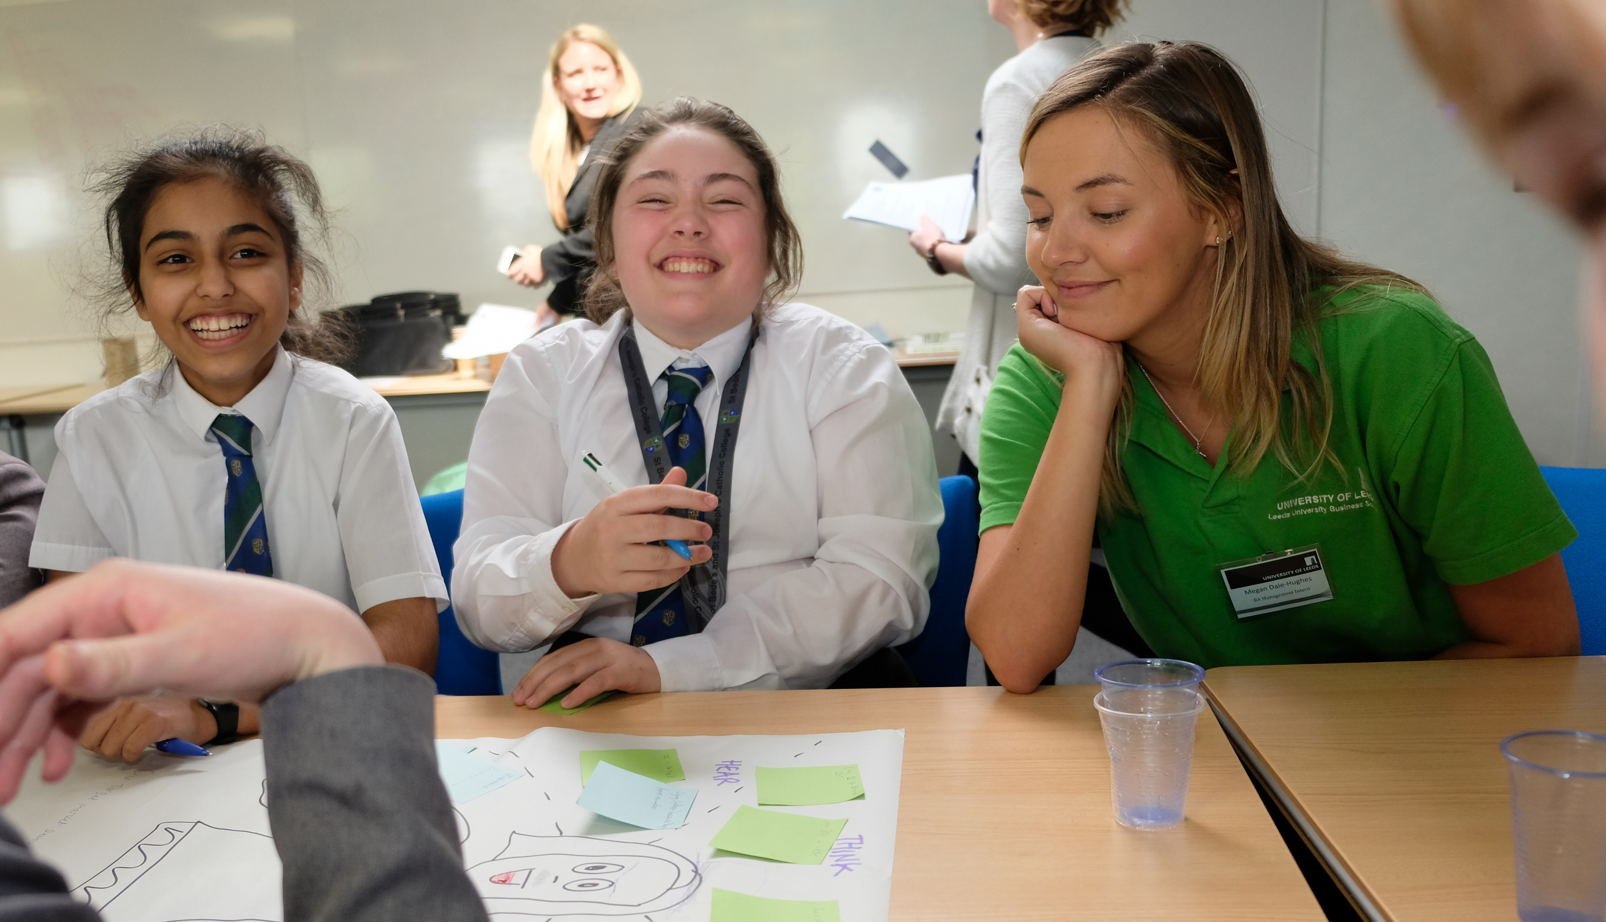
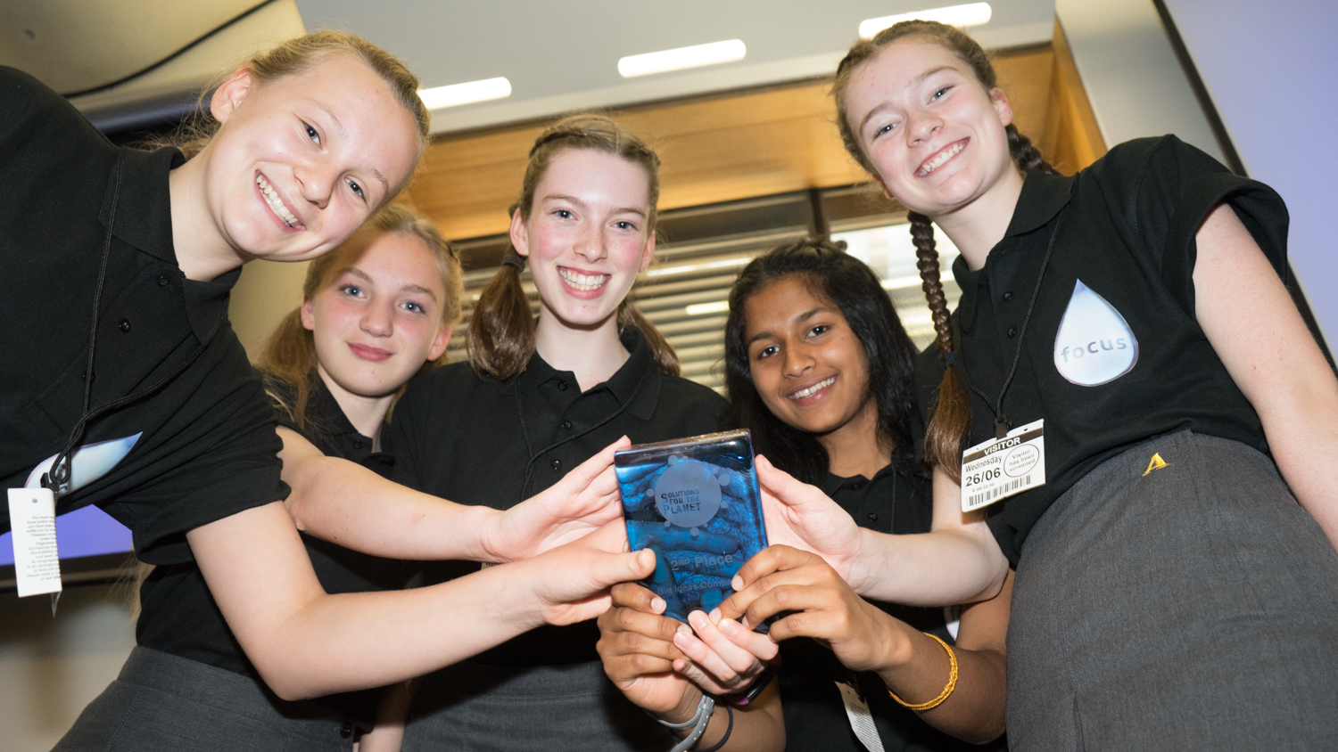
Agenda
(Re)-introductions
Development sessions Overview
What to submit?
Your Roles in development sessions
Resources and Support
Development Session 1
Development sessions Key Info
Communication

Slide 3
The Development Sessions
Take place after the Big Ideas Day
Minimum of 4 teams continue (maximum 10-12)
Lunchtime/curriculum time/after school
Regular 1-hour sessions
Minimum of 7 sessions between Big Ideas Day and submission date (March 19th)
S4TP provides resources and framework to support sessions​
Organised and led by teacher​
Supported by mentors (and S4TP)
Teams develop Business Plans and PowerPoint Presentations (which include any challenge work they have completed)
OPTIONAL challenges set for teams – after each development session, to be undertaken in students’ own time, available on website

Slide 4
Big Ideas Programme – The Journey
Between 60 – 150 students each BID
Between 16 – 150 students in teams at each school
Big Ideas Day
Teacher & Mentor Training
Pre- Development Sessions Training Call
Development
sessions 1 - 7
Masterclasses / Drop-In sessions
1 - 7
Submissions
deadline
Shortlisting Events
Debrief session
Regional
Finals
Up to 12 Teams per Regional Final
Students practice
presentations
Drop-In sessions
Re-
submissions
deadline
Students incorporate
judges' feedback
Drop-In sessions
Debrief session
National Final
Students incorporate
judges' feedback
Drop-In sessions
Presentation skills training
Final submissions
deadline
Debrief session
12 Teams

Slide 5
Big Ideas Programme – The Journey
Review of BID; Choose an Issue; Teambuilding
Research Skills
Introduction to the Business Plan
Branding and Marketing
Networking
Business Model and Finances
Preparing for Submission
Development session 1
Development session 2
Development session 3
Development session 4
Development session 5
Development session 6
Development session 7
Challenge 1
Challenge 2
Challenge 3
Challenge 4
Challenge 5
Challenge 6
Challenge 7
Design a Superhero
Option A: Facts and Figures
Option B: SDG Poem or Rap
Option C: Year 5 Leaflet
Option A: Write a speech
Option B: Make a prototype or animation
Option C: Create a storyboard
Option A: Customer Profile or Empathy Map
Option B: Market Research Survey
Option C: Create a TV or Radio Advert
Option A: Social Media Campaign
Option B: Elevator Pitch
Option A: Business Model
Option B: Start-Up Costs
Meet the Team
Video

Slide 6
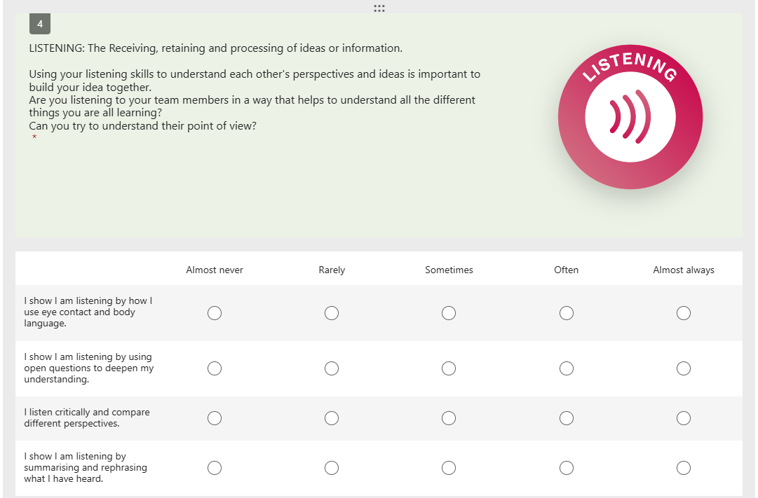
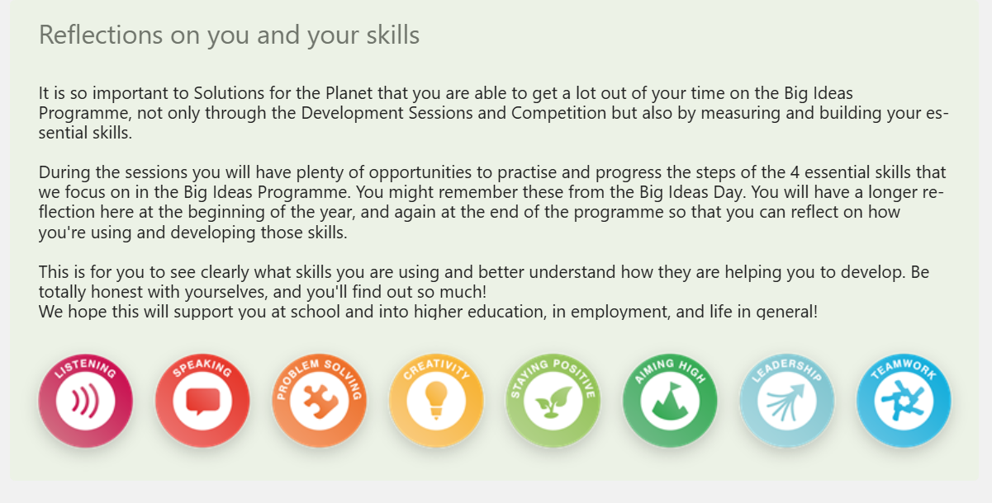
Skillsbuilder
Skillsbuilder is a way for students to actively reflect on how they have practiced their skills during the Development Session process.
We hope that this will provide them clarity on and confidence in the skills they have developed.
It provides a tangible proof of development which can rewarding.
It’s something they could keep and use to help them throughout their educational career and beyond.
Teachers can lead on this as there is a lot of text, but it’s really important to understand the purpose and how to reflect. After the first time we hope there will be a familiarity.

Slide 7
What to submit?
Initial Submissions deadline (March 19th 2025):
Completed Business Plan
PowerPoint Pitch (which includes any challenge work the team has completed)
National Final (July 2nd, 2025 - TBC): ​
Regional Finals (12th – 23rd May 2025): ​
Teams incorporate feedback from the Regional Finals’ judges
Updated Pitch and Business Plan
Teams prepare a 5-minute pitch to present
Teams incorporate feedback from the Shortlisting judges
Teams prepare a 5-minute live Pitch to present alongside their (updated) PowerPoint Pitch
Updated Business Plan

Slide 8
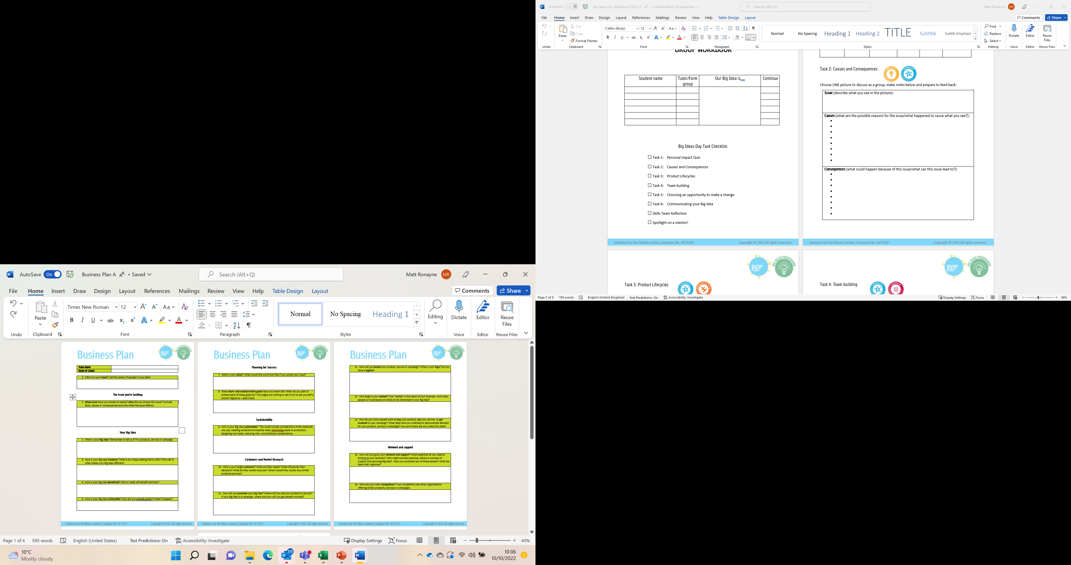
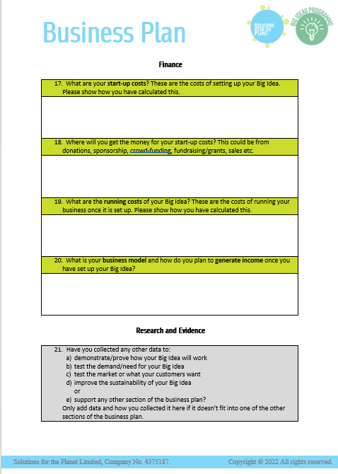
The Development Sessions and the Business Plan
21 Questions
Split into 8 sections;
1. The issue you are tackling
2. Your Big Idea
3. Planning for success
4. Sustainability
5. Customers and Market Research
6. Network and Support
7. Finance
8. Research and Evidence

Slide 9

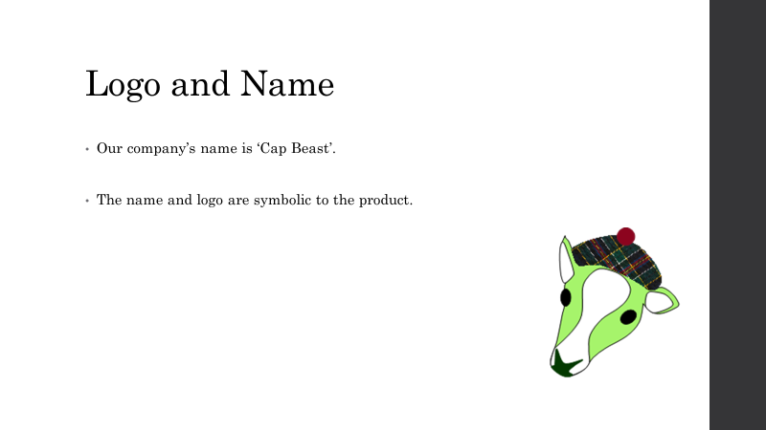

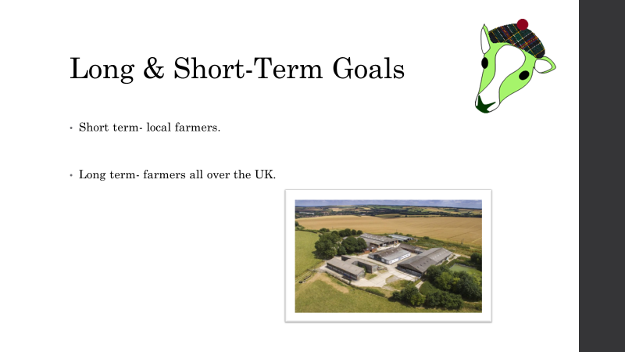
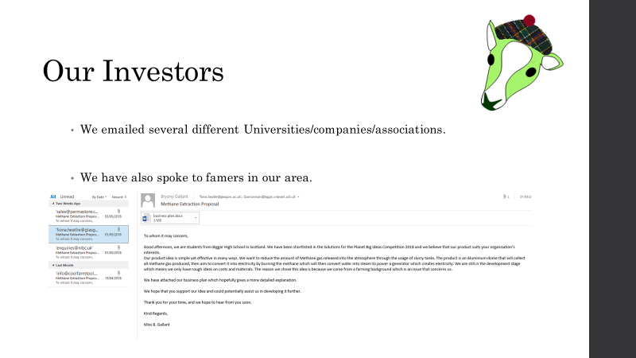


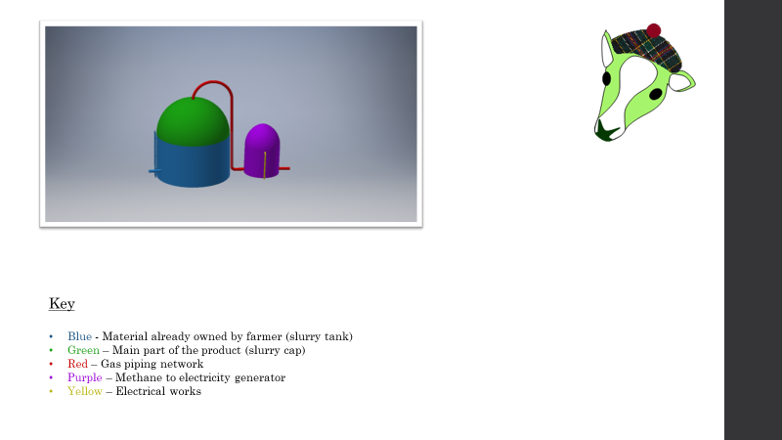

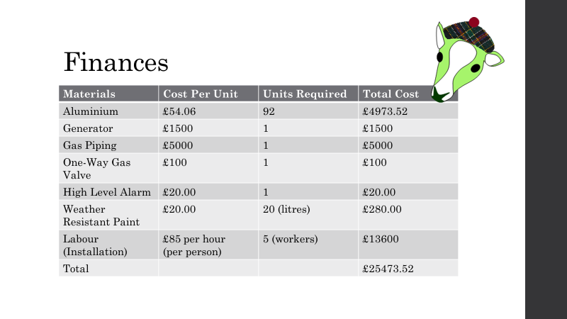
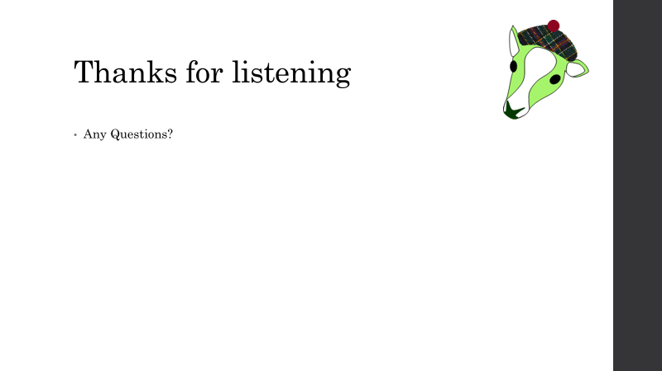
‘The Pitch’ PPT Presentation
To be submitted with the Business Plan.
Example of a submission stage PPT Pitch:
Cap Beast, Biggar High School, South Lanarkshire – 2017/18 National Finalists

Slide 10


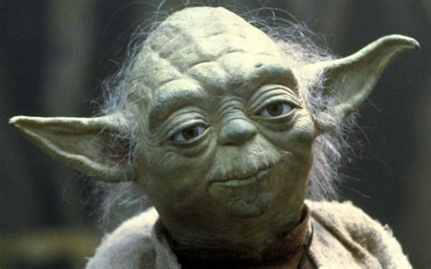
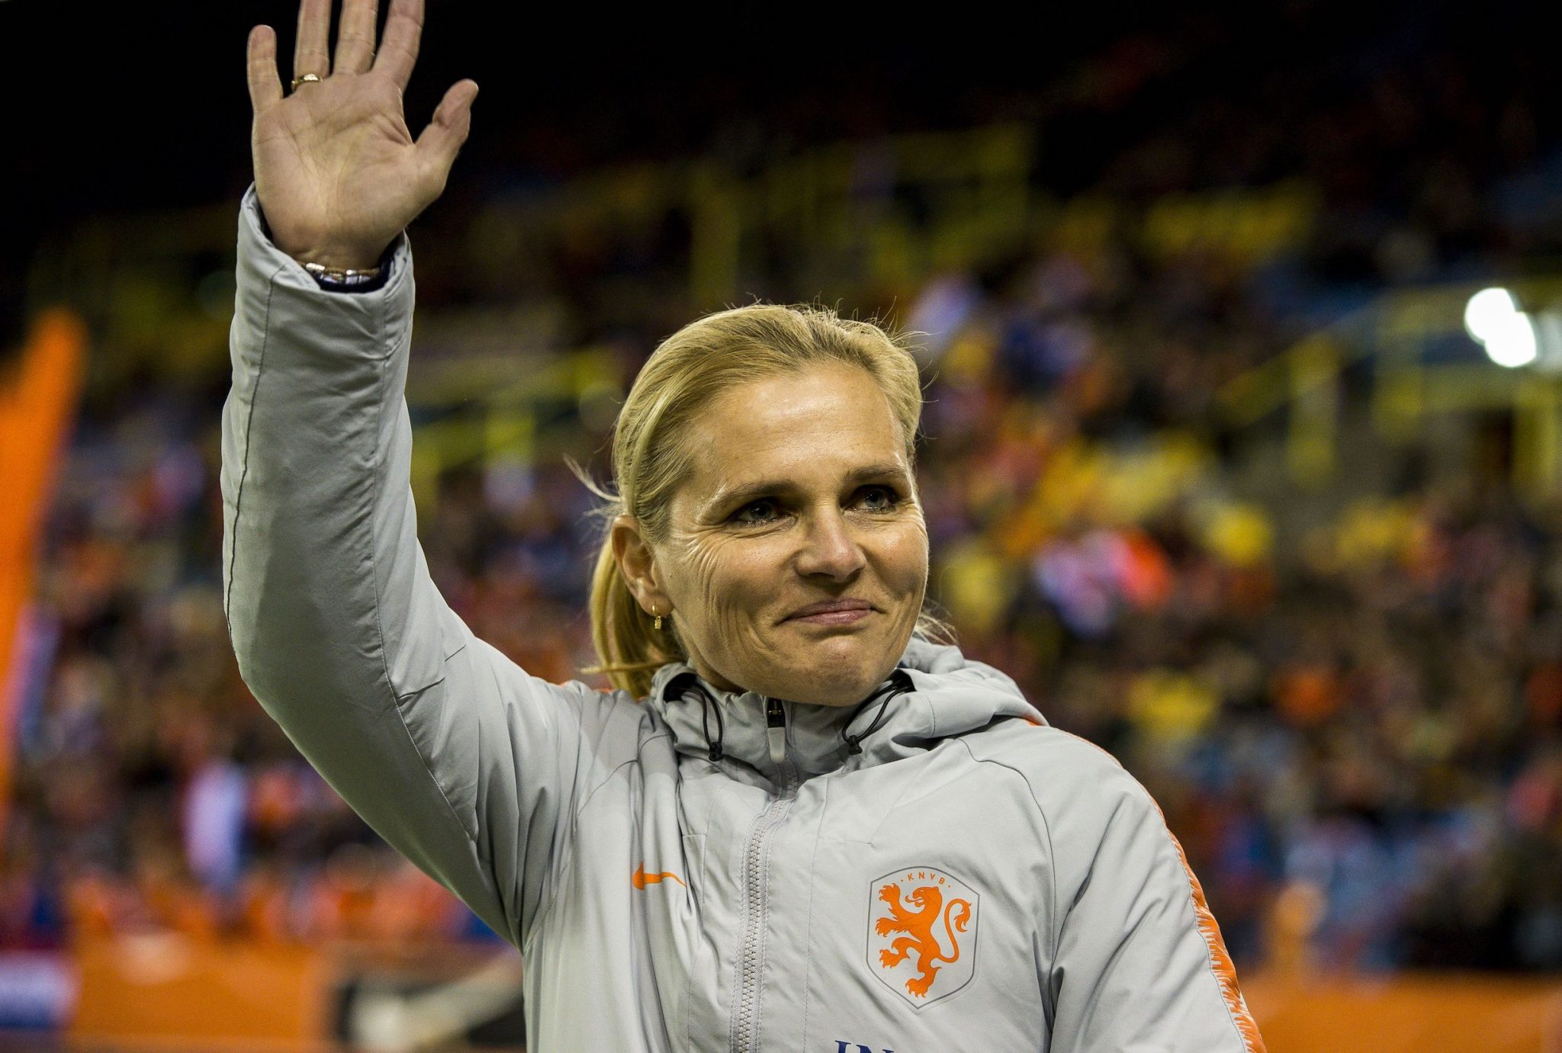


What is a Mentor?
Guide
Advisor
Guru
Supporter
Coach
Motivator

Slide 11
Roles in Development Sessions
Teachers – to organise and facilitate the session
let the mentors know what you will be focussing on in the session.
give as much notice as possible if a session needs to be cancelled or postponed
direct mentors to which teams it would be useful to work with
teachers are there to mentor the teams too
Mentors - to support with different teams.
give as much notice as possible if you are unable to make a session – and see if another mentor can take your place, or advise teachers when you will be able to come instead
Attend 3 sessions (more if you are able to ☺ )
advise teams like you did on the Big Ideas Day.
bring in your expertise from work and life experience
ask teachers for direction if unsure

Slide 12
What should you do?
5 R’s model
Listen – Do not commit to Secrecy
Report – Tell the Facilitator from S4TP and the lead teacher at the school.
RECOGNISE – Signs of abuse/disclosure
RESPOND – Follow the disclosure process
REPORT – Contact S4TP’s Big Ideas Programme Manager or Coordinator and School Safeguarding Lead
RECORD – Write down the facts as accurately as possible.
REFER – Big Ideas Programme Manager or Coordinator refer to S4TP Designated Safeguarding Lead (Jen Baughan) who will take necessary steps
Our mentors will not be asked to be DBS checked as part of the programme

Slide 13
What steps S4TP have taken…
All S4TP staff have Child Protection training including the 5 R’s model.
Child Protection and Safeguarding Policies and Procedures
Ask all mentors to agree to the above and sign a Code of Conduct – this is to be done before the first Big Ideas Day/school visit
Appoint a Designated Safeguarding Lead – Jen Baughan
All S4TP Staff have DBS Checks and are signed up to the update service
IMPORTANT: As all activities on the Big Ideas Programme, are ‘regulated’ either by S4TP or the school, mentors are not required to be DBS checked so should never be left in a position where they are alone with students.

Slide 14
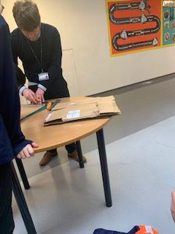
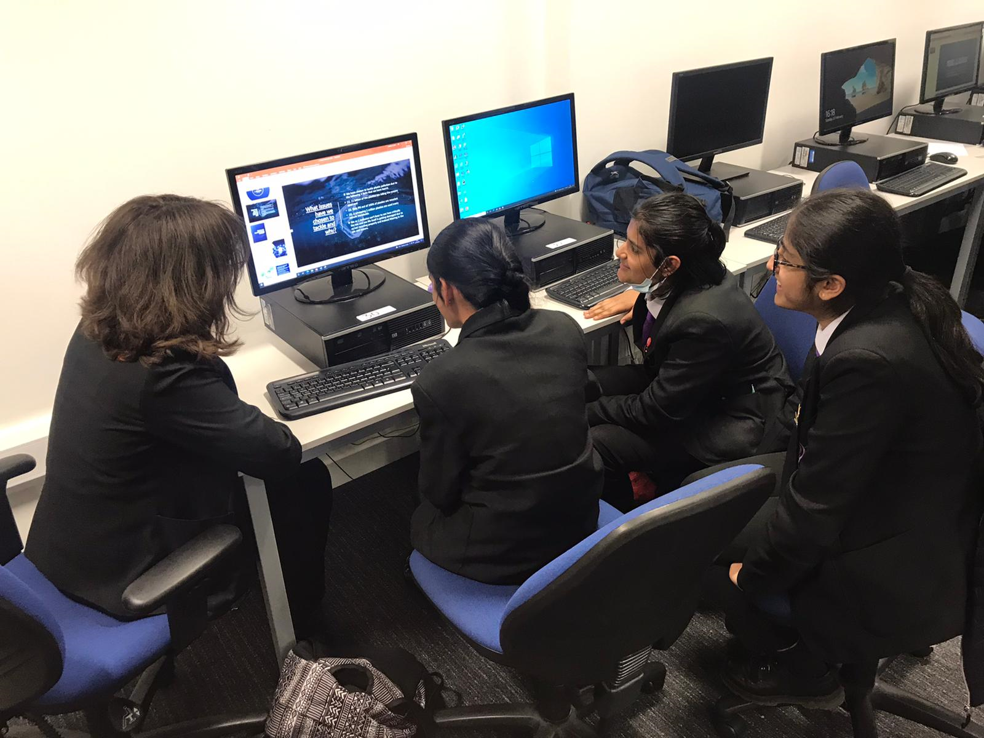
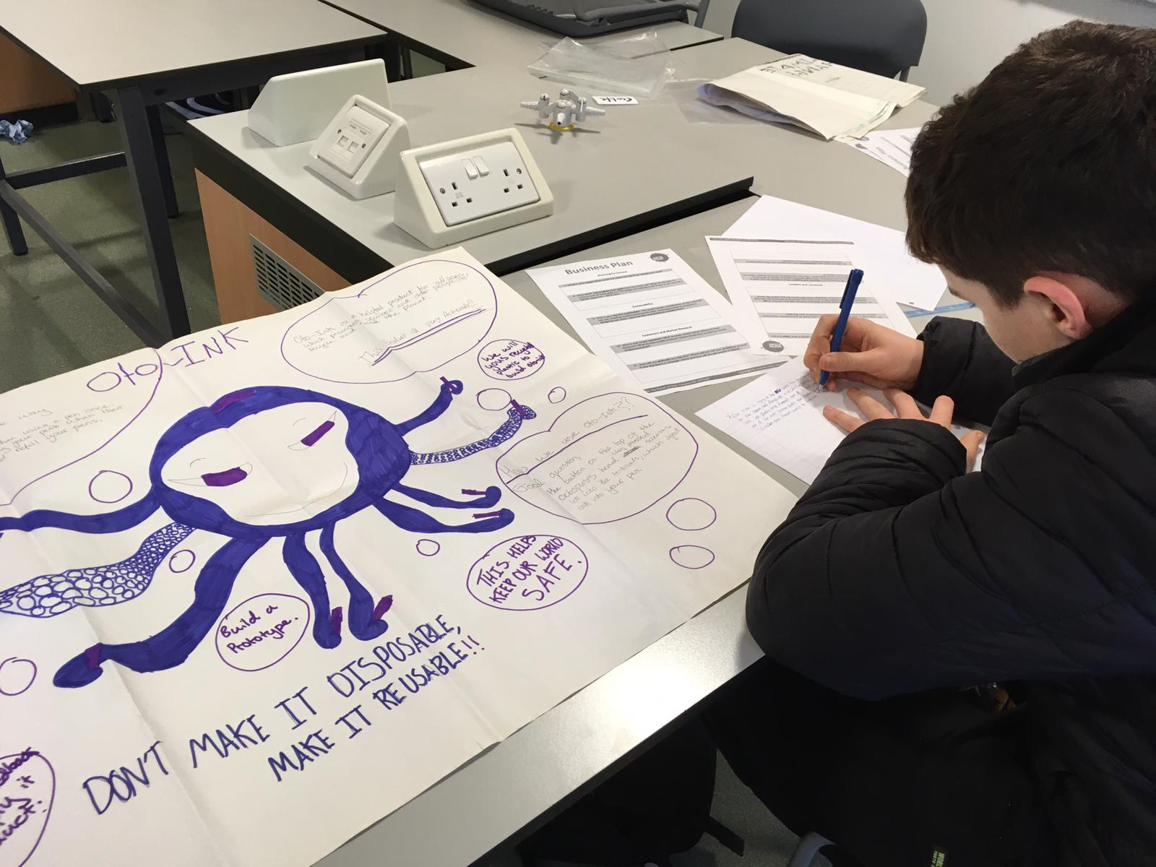
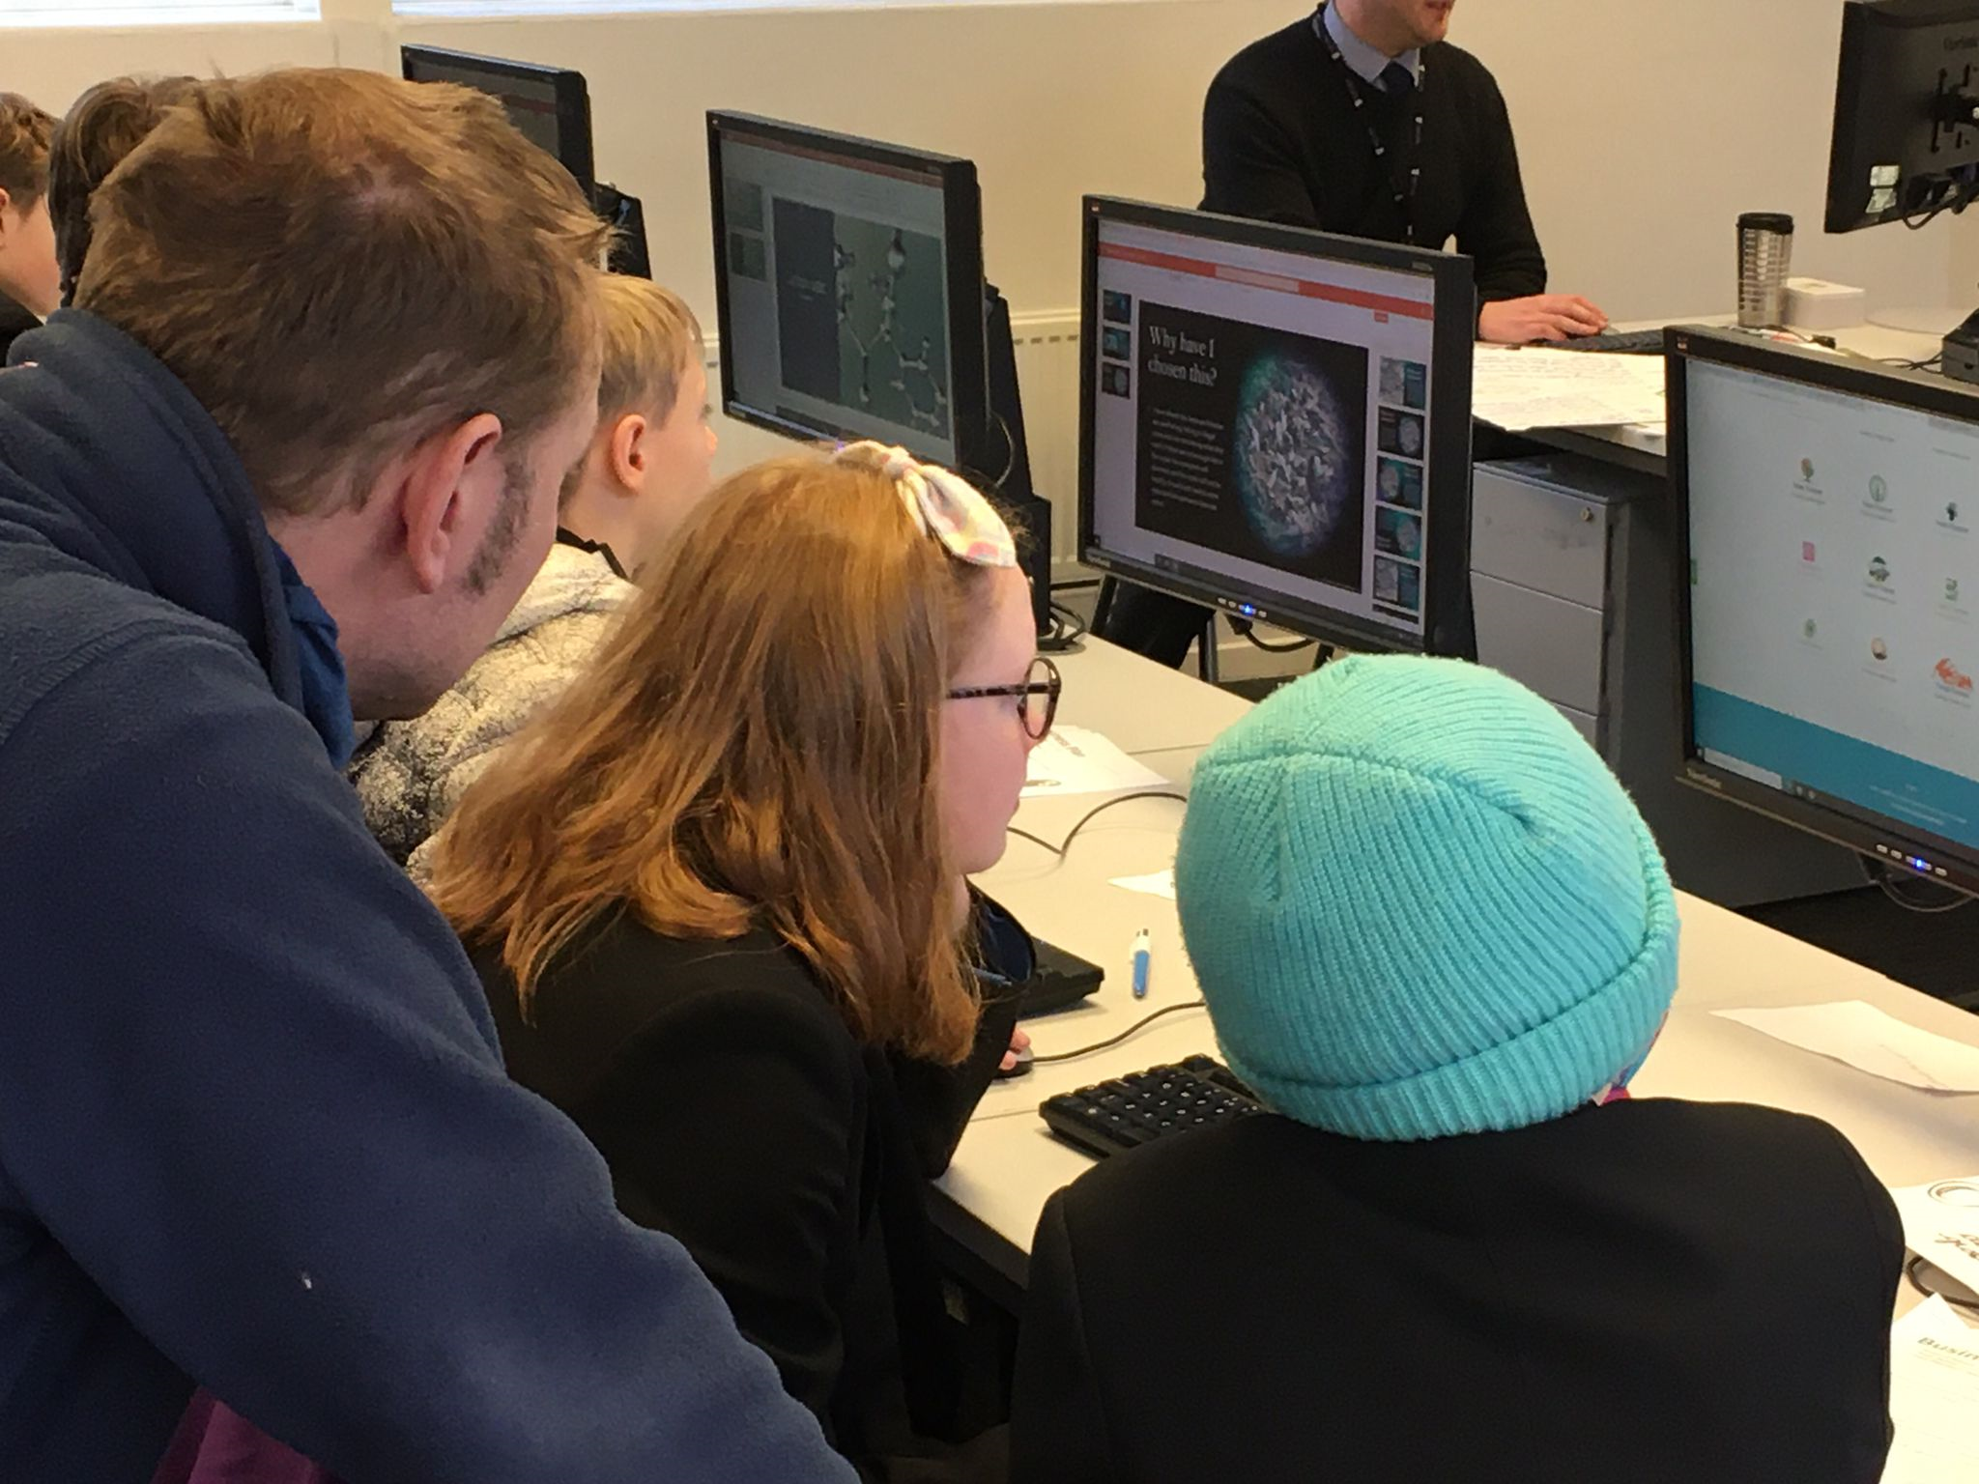
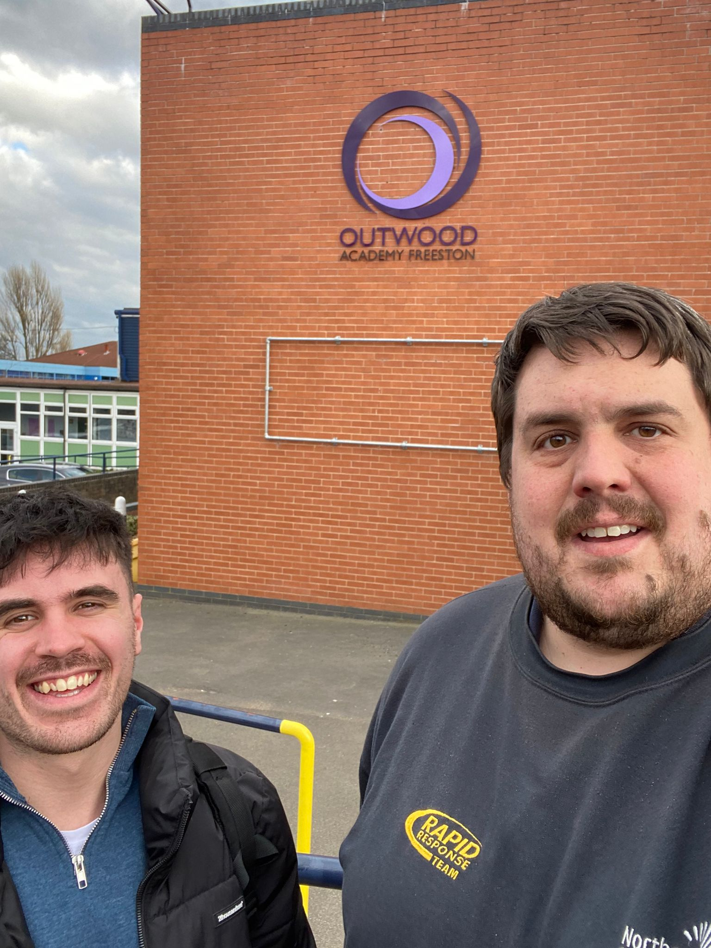
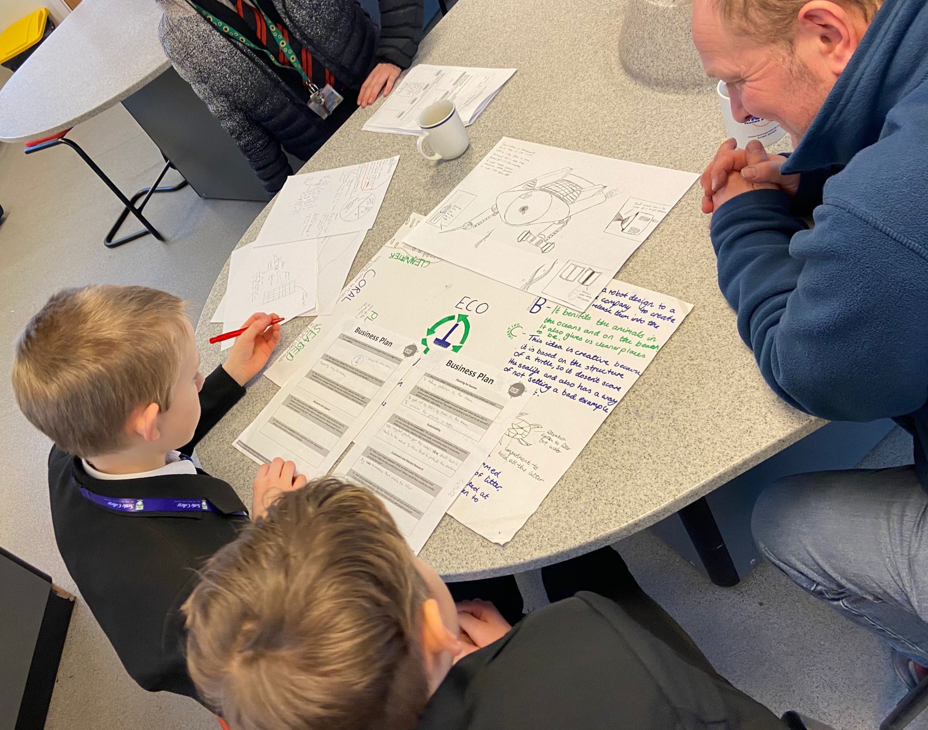
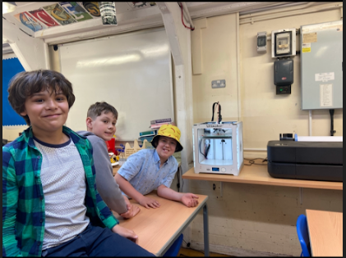
What do development sessions look like?

Slide 15
Idea Killers!
NO!
We don’t have time!
It’s not possible…..
Yes, but….
It’s too expensive
The older generation won’t use it
It already exists!
That’s not logical…
Let’s be realistic…
There’s no budget…
Our customers won’t like that!
It might work in other places but not here
It’s not my responsibility…

Slide 16
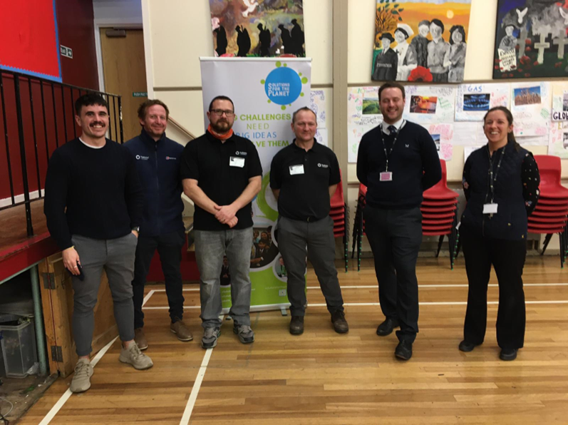
Ongoing Resources & Support
Access to the Training session slides
Teacher notes and documents for 7 Development Sessions
‘Masterclass’ videos on Business Plan sections
Pre-Development Sessions training call with S4TP for teachers and assigned mentors
OPTIONAL weekly Drop-In sessions

Slide 17
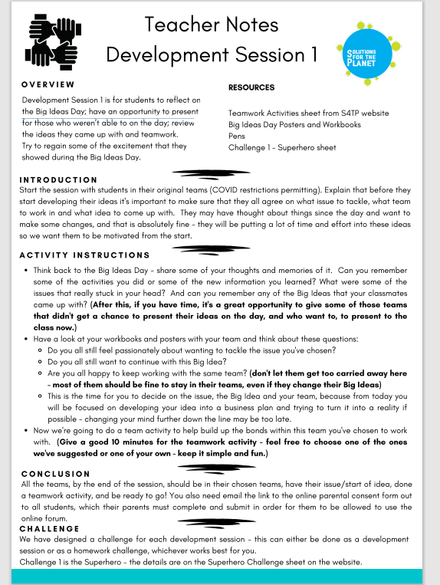
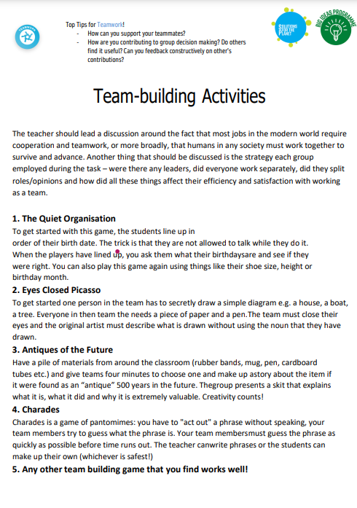
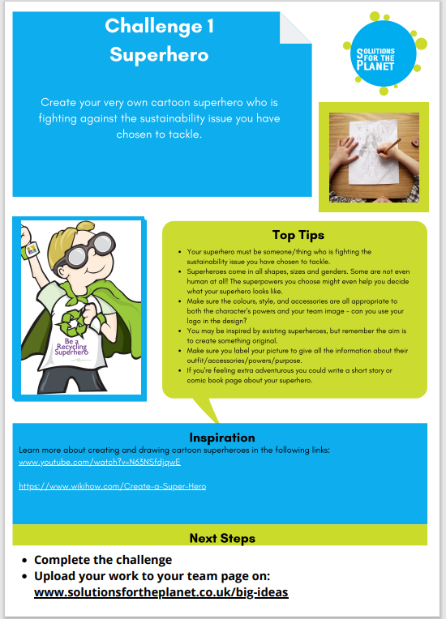
Development Session 1

Slide 18
Development Session 1
It is for students to reflect on Big Ideas Day
To have an opportunity to present if they did not on the day.
Review the ideas they came up with.
Regain the excitement they showed on the Big Ideas Day.
Start the teams in their original teams
Do they still feel passionate about the issue they chose to tackle?
Are you happy to keep working with your team?
Do you still want to continue with this Big Idea?
By the end of this session you should establish all of the teams that will be continuing in the development sessions.
Resources you will need:
Big Ideas Posters
Workbooks
Pens

Slide 19
Development Sessions Key info – from teachers
When will development sessions be running? (Dates/times)
How many teams/which teams are continuing?
Practicalities – parking, signing in, etc.

Slide 20
Communication
We need to decide how we will communicate with each other throughout the development sessions.
Is email best for everyone?
Are you happy to make a group WhatsApp?

