Slide 1

“Sharing knowledge and skills to shape the future”
www.solutionsfortheplanet.co.uk
Solutions for the Planet Limited, Company No. 4375187. Copyright © 2018 All rights reserved.

Slide 2


Marketing your Big Idea
Solutions for the Planet Limited, Company No. 4375187. Copyright © 2018 All rights reserved.

Slide 3
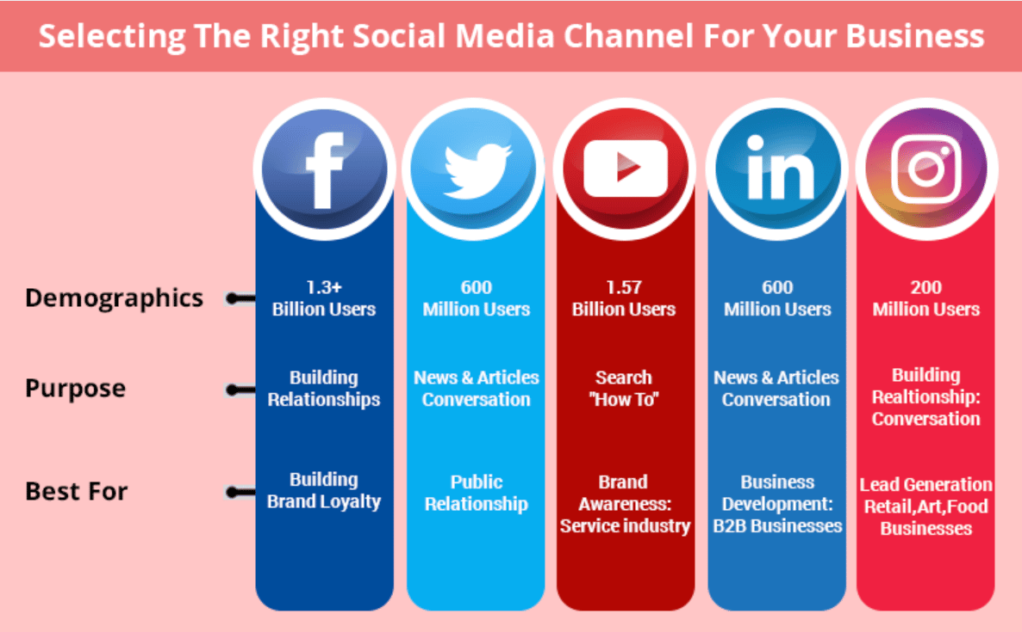



Other channels to consider...
Source: https://www.socialpilot.co/blog/social-media-channels-for-business
Solutions for the Planet Limited, Company No. 4375187. Copyright © 2018 All rights reserved.
Notes:
Different channels are used for different things and target different people
EG. Instagram is a very visual channel and is best for promoting campaigns with strong visual images
X (or Twitter) is a fast paced channel and is best for starting discussions, engaging people, and posting regularly
Different channels better for different businesses depending on target market, business aims and product/service
Start thinking about which channel(s) might be best to promote their products or services...

Slide 4



What is a Target Market?
Solutions for the Planet Limited, Company No. 4375187. Copyright © 2018 All rights reserved.
Notes:
What is a target market?
Who do they think the target markets are for these 3 things?
What is it that defines a target market or target audience...?

Slide 5
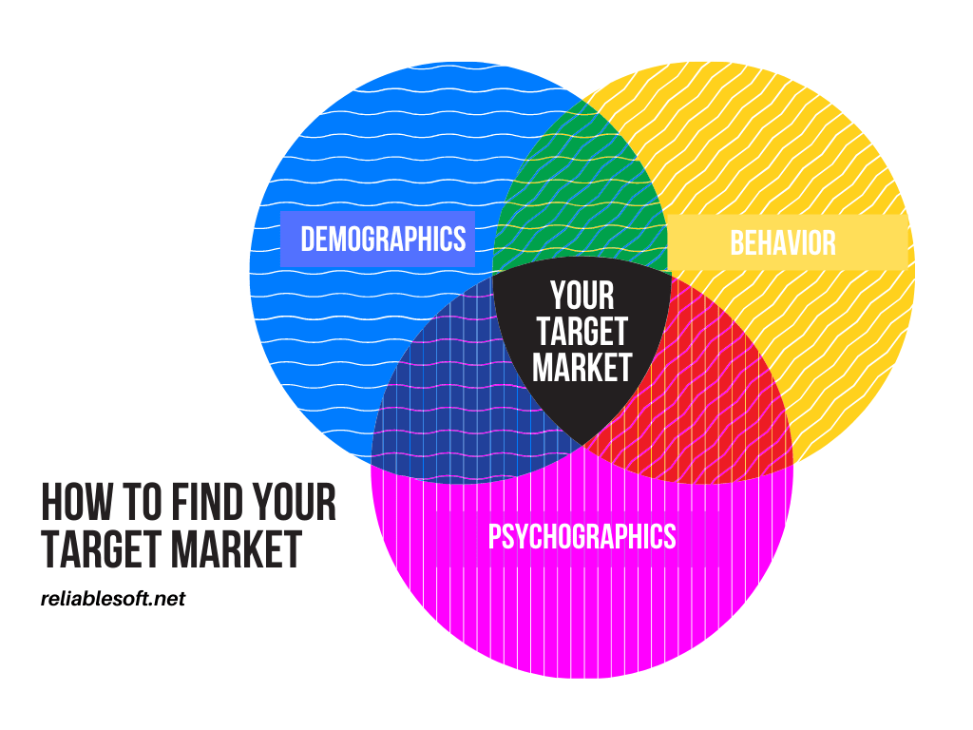
Define your Target Market?
Gender
Age
Location
Income
Family status
Race
Interest
Hobbies
Habits
Beliefs
Values
Goals
Attitudes
Solutions for the Planet Limited, Company No. 4375187. Copyright © 2018 All rights reserved.
Notes:
To define your target market, think about what sort of people will be most interested in your produce or service?
Use the graph and write down as much detail as you can about your target market.
Now go back to the table of social media channels and think about which channel will best capture your target audience?

Slide 6
What sort of CONTENT?
Information about your product or service
Information that might interest your target audience
Fun or funny content
Information about the problem you are trying to solve
Information about who you are and why you're starting your business
Behind the scenes information about your business
Content that people want to share!
Solutions for the Planet Limited, Company No. 4375187. Copyright © 2018 All rights reserved.
Notes:
Anything posted onto social media is called content
The content you post will be somewhat determined by the channel you choose to use and your product or service
Have a think about all the different things you could post about that we to do with your business or that might be interesting to your target audience

Slide 7
Content top tips!
Keep it short and to the point
Social media is face paced and people won't read anything too long. Keep your posts short and sweet!
Use hashtags
Hashtags are a powerful tool that allow you to expand your reach and tap into relevant conversations. Focus on keywords that are relevant to your business.
Use photos, graphics or videos
Using images is essential to make your content go further. Videos are even better. Find a brand style and try and make sure all your content fits within it.
Ask questions and try to build engagement
Use things like questions, quizzes, polls and games to encourage your followers to engage with and share your content.
REMEMBER...the aim is to get as many people as possible to see your content!
Solutions for the Planet Limited, Company No. 4375187. Copyright © 2018 All rights reserved.

Slide 8
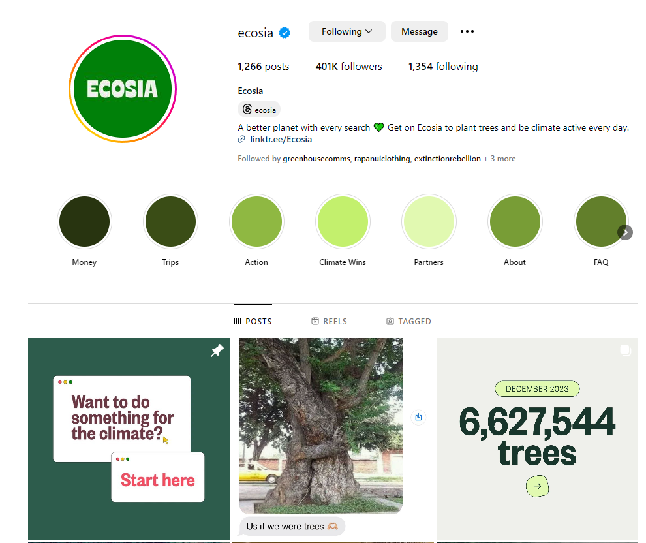
Case Study
Strong branding
Funny content for engagement
Pinned content about who they are
Informative content about their mission
Solutions for the Planet Limited, Company No. 4375187. Copyright © 2018 All rights reserved.
Notes:
Do some research and find your top competitors in the market. What are they doing on social media?
Can you find more examples of similar companies that have good social media campaigns? What can you learn from them?

Slide 9
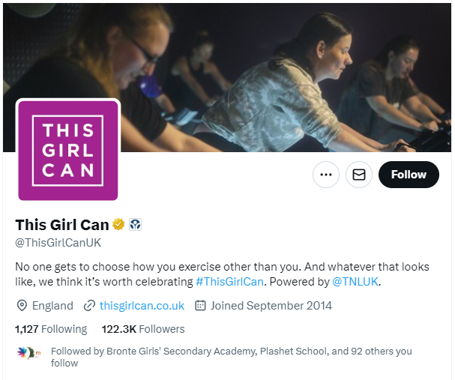
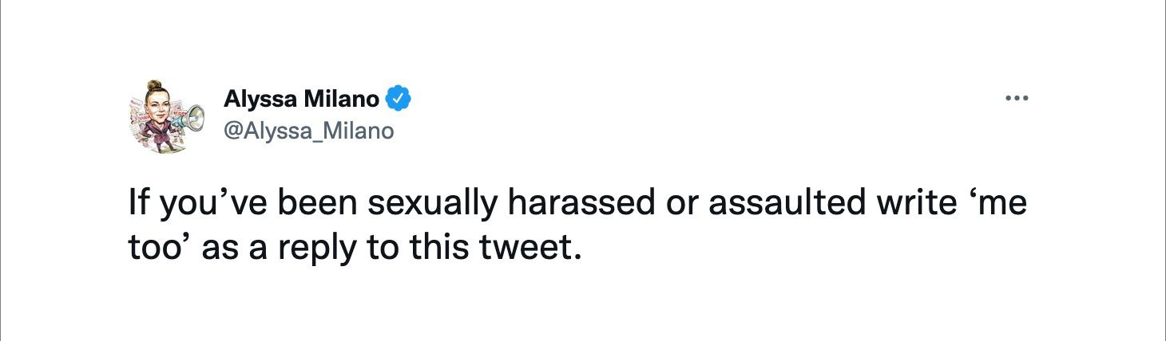
Hashtag Campaign examples
#metoo posted more than 13 millions times in less than a week following this post
#thisgirlcan was trending at number 3 in the UK on the first day of airing and the YouTube video of the ad has had over 400,000 views
Solutions for the Planet Limited, Company No. 4375187. Copyright © 2018 All rights reserved.
Notes:
What makes a good hashtag?
What hashtags might be useful for your campaign?
Create a list of all the hashtags you can think of that could be used to promote your product or service...think creatively about what your product is for, what problem it's tackling and who your target audience is.

Slide 10

Getting started with social media
Identify your target market
Choose your platforms
Brainstorm your content
Get posting!
Solutions for the Planet Limited, Company No. 4375187. Copyright © 2018 All rights reserved.

