Slide 1
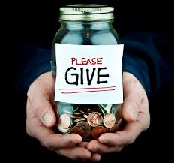



How will you run your business?
4 Business Models
Personal
Charitable
Good causes
Philanthropic
Social Enterprise
Profit-driven
Notes:
People choose to run their businesses in different ways. Solutions for the Planet is a social enterprise which means that we are a business which makes profit but reinvests all its profits back into the business for social and environmental purposes. The owner and shareholders do not make any money from the business.
Profit driven – focusses on making money for its owner or shareholders
Philanthropic, profit driven but gives away a proportion of its profits to good causes
Charity – secure income from grants and donations

Slide 2
What is a Social Entrepreneur, and do you have what it takes to be one?
Notes:
Do you have what it takes to be a social entrepreneur? University of Greenwich, written by Charles Oham, produced by Codelogix
https://www.youtube.com/watch?v=0w3xGCojNcc

Slide 3

Notes:
Do you have what it takes to be a social entrepreneur? University of Greenwich, written by Charles Oham, produced by Codelogix
https://www.youtube.com/watch?v=0w3xGCojNcc

Slide 4
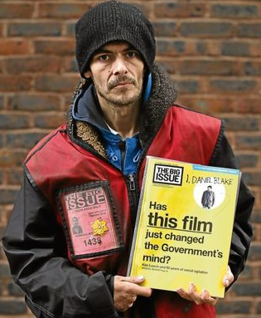
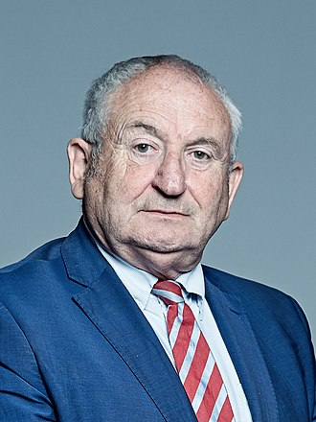

What is a Social Entrepreneur?
6 things that all social entrepreneurs have in common
Problem Solving
Creative thinking
Flexibility
Team building
Altruism
Commitment
Baron John Bird is the founder of The Big Issue
Do you have what it takes?
Notes:
Can you remember the 6 important attributes of a social entrepreneur?
6 things that all social entrepreneurs have in common
They identify problems in the world and get upset enough to want to solve them
They think creatively
They are flexible and aren’t afraid of change
They build teams
They are not in it only for the money
They stay committed until the identified problem is resolved
They are really good at bringing different people who have different ideas, experiences and skills together to form a team to create a new kind of business
They are excited about the difference they’re making. They eat, breathe and sleep their business. Their excitement gets other people excited to make a difference too.
[The photo: Baron John Bird is a British social entrepreneur and life peer (a non-party-political people’s peer). He was homeless through periods of his life, and is best known as the founder of The Big Issue, a magazine that is edited by professional journalists and sold by street vendors who are homeless or vulnerably housed.
Vendors buy The Big Issue magazine for £1.25 and sell it for £2.50, meaning each seller is a micro-entrepreneur who is working, not begging. Therefore it is vitally important that buyers take their copy of the magazine when they pay for it. That is how he has made the model sustainable.]
So we’ve heard that social entrepreneurs are not trying to become millionaires (although some do make a lot of money!). They are trying to solve problems to improve the lives of millions of people. It’s about using a business to put right the problems in society.
So – do you have what it takes to be a social entrepreneur? We believe you all do! And we’re here to help you find a way to put right the problems that you want to deal with! Are you ready to work on your Big Idea? Let’s go!

