Slide 1
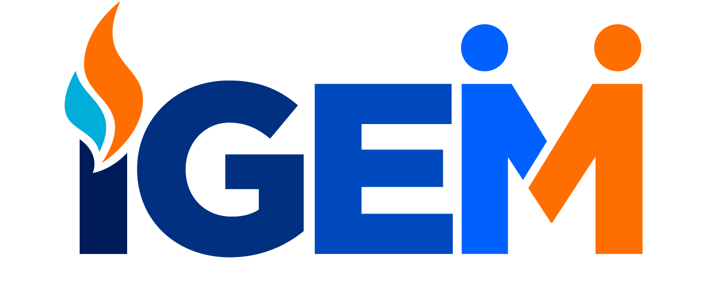
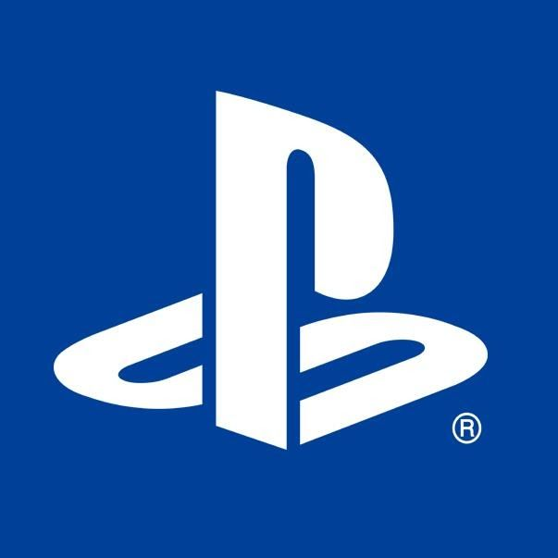
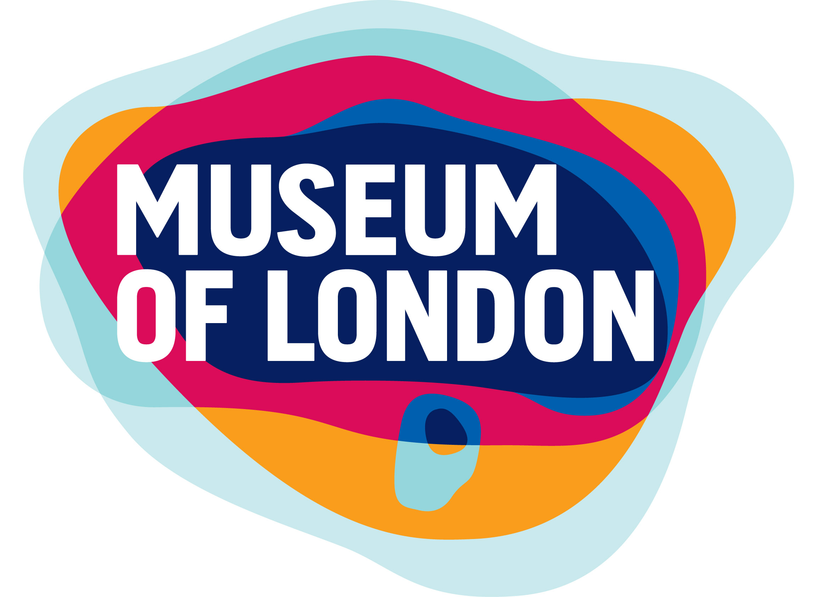
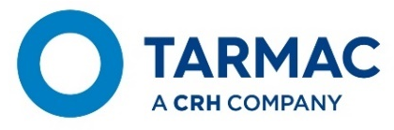
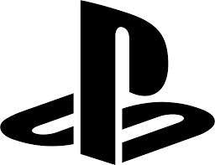
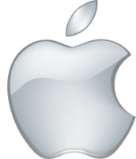
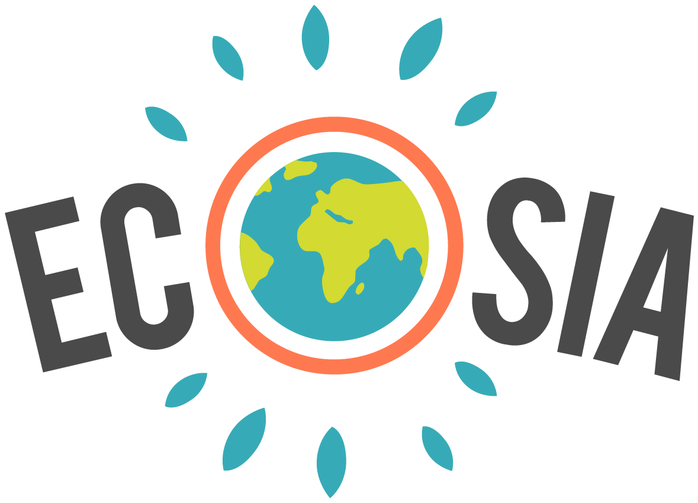
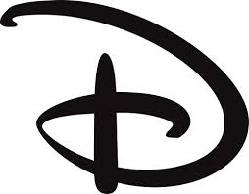
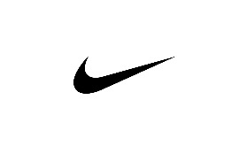
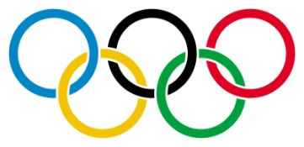
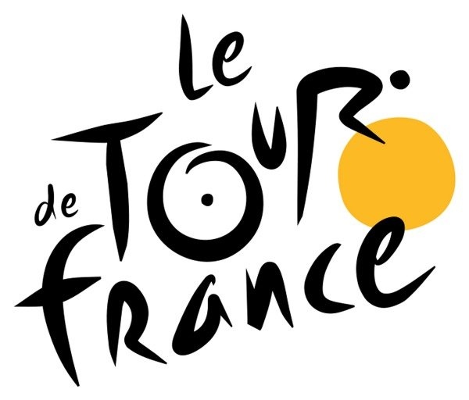
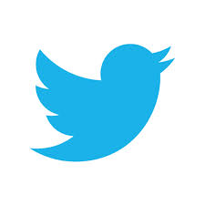
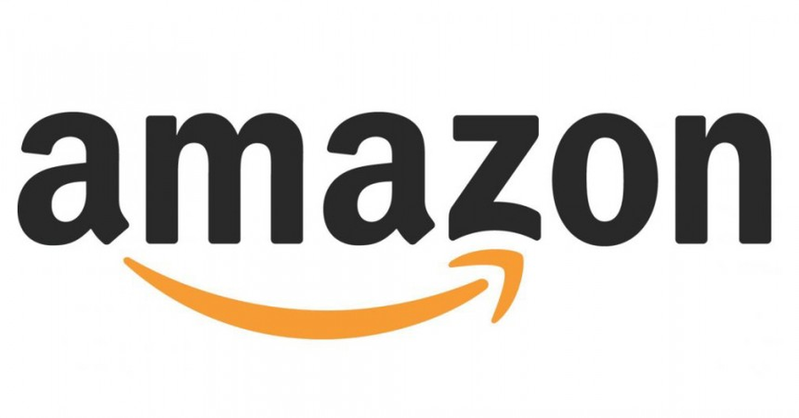
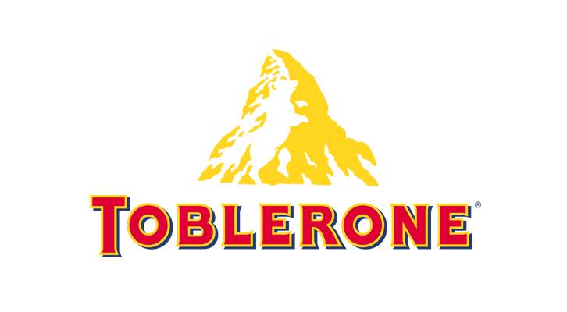
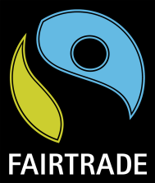
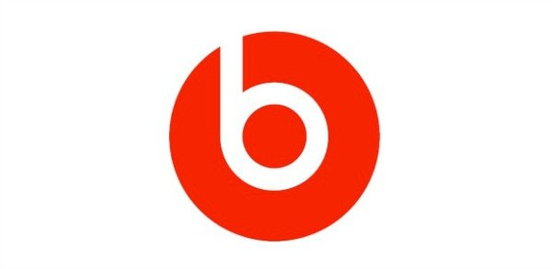
  What’s in a name? What’s a brand?
Solutions for the Planet Limited, Company No. 4375187. Copyright © 2020 All rights reserved.
Notes:
Branding
Branding is more than just a logo and a slogan, but they are a good place to start.
For example, take a look at all these strong brands on the screen.
First of all – let’s just start generally – what do you notice about the logos in general? Can you describe them? Think about things like the colours used, how they look , what impact they have on you, etc. (simple designs, not too many colours, bold and bright, sometimes just a symbol, some have hidden messages and meanings, etc)
Can you tell me which organisation/company the logo represents and if there are any hidden meanings/messages?
How about slogans – does anyone know what we mean by the word ‘slogan’ or ‘tagline’? Can you give me a few examples? So what makes a good slogan? (catchy, simple, rhyming, funny, etc.)
A logo must be simple. A logo must be memorable. A logo must be enduring. A logo must be versatile. A logo must be appropriate.
Museum of London - London is built on other Londons – Medieval London, Roman London, whatever there was before London. The logo has an interesting, organic look. The shapes of colour actually represent something, though, and aren’t just abstracted blobs of colour. They show the geography of London and how it has changed over time, representing the constant change of London and its people in the past, the present, and looking towards the future.
IGEM – IGEM (Institution of Gas Engineers & Managers) is one of our business partners, and is a membership networking organisation for people working in the gas industry. The ‘hidden’ messages are two people meeting/shaking hands and a gas flame.
Playstation – the 'shadow' of the P is the S for PlayStation. It’s a powerful enough brand that it can be recognised by a symbol alone.
Nike – The Nike “Swoosh” logo symbolizes the wing in the far-famed statue of the Greek Goddess of victory, Nike, who largely influenced countless brave warriors. The Swoosh is a sound that we hear when something zips past quickly by our side. This word stands for fast sound, speed, and motion. It’s a powerful enough brand that it can be recognised by a symbol alone.
Disney – inspired by Walt Disney's signature. It’s a powerful enough brand that it can be recognised by a symbol alone.
Olympic Rings - The Olympic symbol expresses the activity of the Olympic Movement and represents the union of the five continents and the meeting of athletes from throughout the world at the Olympic Games. The full-colour Olympic rings are the embodiment of Pierre de Coubertin’s original vision; “full-colour” refers to the six Olympic colours – blue, yellow, black, green and red on a white background – which symbolise Olympism’s universality. Though he is believed to have stated that his design was 'truly an international symbol' with the six colours (white included) reproducing the colours of all nations, as they appear on the flags of the world; i.e. "blue and yellow of Sweden, the blue and white of Greece, the tricolours of France, England and America, Germany, Belgium, Italy, Hungary, the yellow and red of Spain next to the novelties of Brazil or Australia, with old Japan and new China.“It’s a powerful enough brand that it can be recognised by a symbol alone.
Ecosia - The search engine that everyone should be using instead of Google! If you haven’t heard of it, check it out and start using it! They use the profit they make from your searches to plant trees where they are needed most. Plant trees with every search. Over 113,500,000 trees planted!
Toblerone - Toblerone is a company from Bern, Switzerland; home to the Matterhorn Mountain (hence the triangular shape of the chocolate) and also known as the “City of Bears”. See if you can spot the bear nestled within the mountain design. This is a great example of incorporating a company’s roots into their logo so they never forget their origins.
Le Tour de France – This logo has two hidden messages inside it. The first is a bit more obvious, with a cyclist making up the letter ‘r’, with the ‘o’ and ‘u’ and yellow circle making up the bike, but the second is more subtle. The yellow circle that acts as the bike’s wheel is also a sun, indicating that the events of the race only occur in the daytime.
Beats - The logo for Beats by Dre is pretty simple. The ‘b’ is enclosed in a circle followed by the brand name. The circle, though, isn’t just a circle. It actually represents a human’s head, and the ‘b’ letterform represents the brand’s headphones. This gives the brand a personal element, allowing a customer to see themselves in the headphones. It’s a powerful enough brand that it can be recognised by a symbol alone.
Amazon - The yellow arrow in their logo starts at the letter ‘a’ and ends at the letter ‘z’, implying that they sell everything from a to z. The arrow also represents a smile, with the arrowhead being a stylized dimple or smile line. The smile indicates the happiness people feel when they shop with Amazon. The brand is becoming even stronger, as they have started using the arrow symbol on its own.

Slide 2
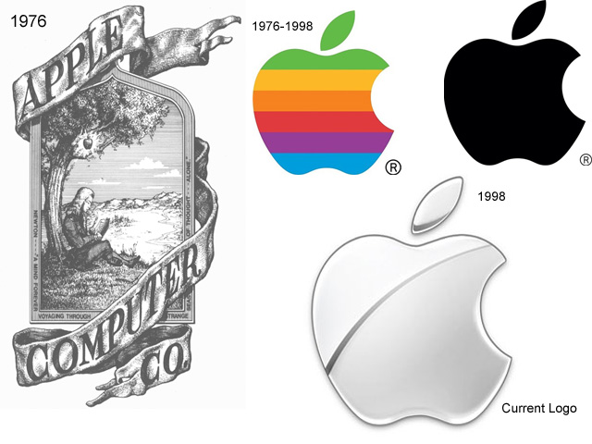
  What’s in a name? What’s a brand?
Solutions for the Planet Limited, Company No. 4375187. Copyright © 2020 All rights reserved.
Notes:
Don’t be afraid to change/adapt/evolve your logo
Look at the first Apple logo compared to now. Sometimes you have to adapt/change/evolve your ideas until you find the one that works – and that doesn't just apply to logos, but to your whole Big Idea itself!
Apple's original logo design was considered quite complicated for its intricate nature.
It depicts the famous story of the discovery of gravity when Isaac Newton was sitting under a tree, and an apple falls on him. The Logo included a quote from William Wordsworth, a romantic English poet; “Newton… a mind forever voyaging through strange seas of thought.” The poem was written on the frame of the logo.
Apple's new logo design used an Apple that was bitten from the right side. The “bite” in the Apple logo was originally implemented so that people would know that it represented an apple, and not a cherry tomato. It also lent itself to a nerdy play on words (bite/byte), a fitting reference for a tech company.
It contained a rainbow spectrum, a nod towards Apple’s computer Apple II, which was the world’s first computer with a colour display. The logo debuted a little before the computer’s launch. There was no rhyme or reason behind the placement of the colours themselves, although Steve Jobs wanted to have green at the top “because that’s where the leaf was.
The rainbow colour logo remained the brand identity of Apple for more than two decades.
When Apple released their first ever iMac, the Bondi Blue, the logo was changed and its rainbow colours disregarded.
The rainbow-colored logo would have looked silly, childish and out of place on the sky-blue computer. They simplified the design to a monochrome look – which was also cheaper to produce than the multicoloured one.

