Slide 1
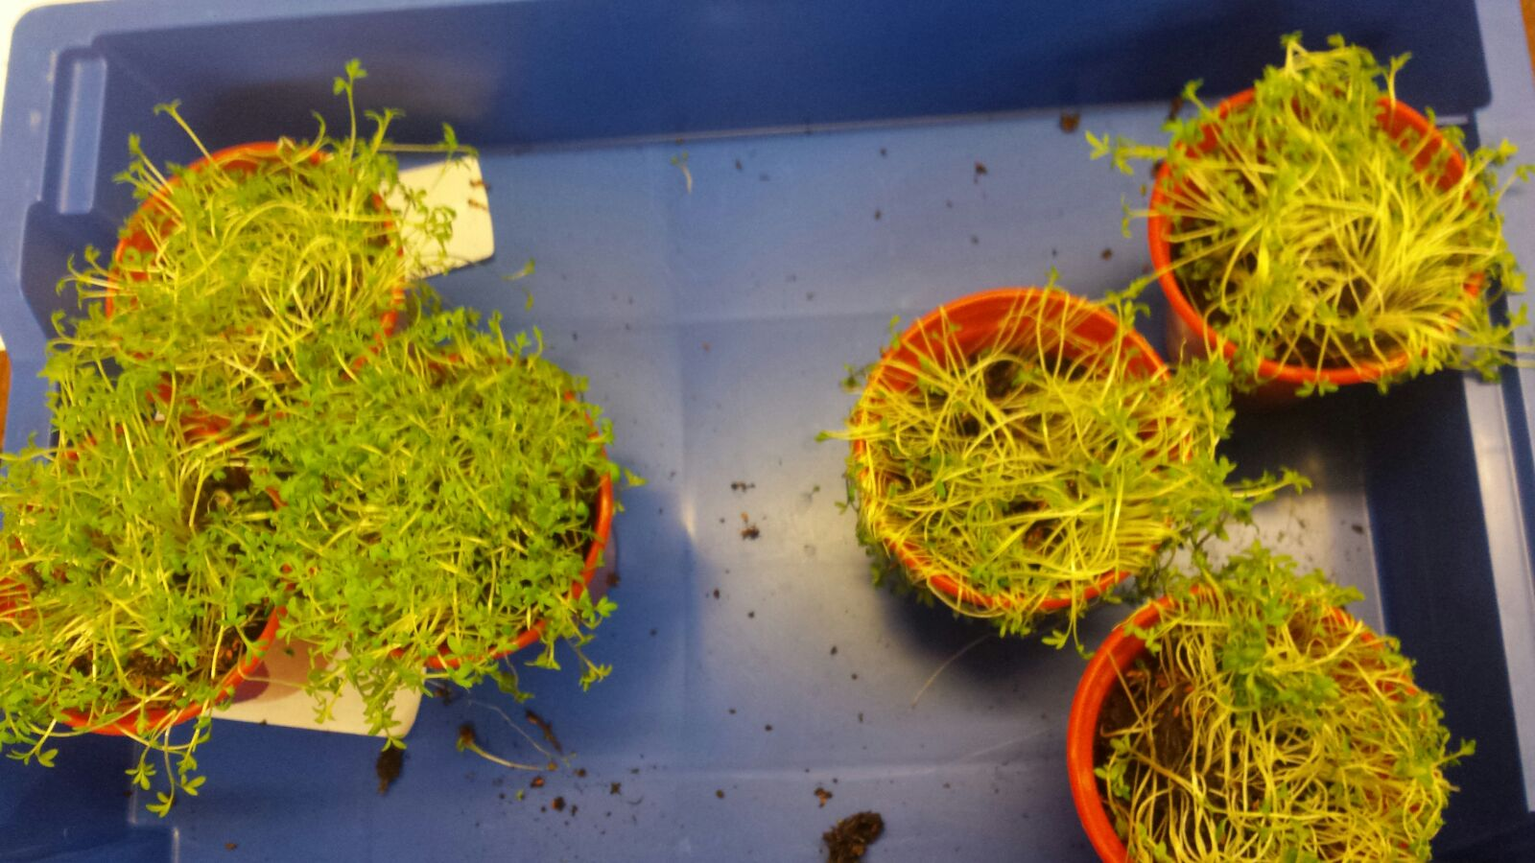


Research skills for developing your Big Idea
Experimental
Control
Solutions for the Planet Limited, Company No. 4375187. Copyright © 2020 All rights reserved.
Notes:
Today we are going to talk about research skills which are an important STEM skill used in lots of industries from the business to construction sectors, and in further education such as sixth form and University. Who can remember what STEM stands for?
Re-cap STEM… Science, Technology, Engineering and Maths- all subjects which allow you to learn and develop research skills. Today we are going to look at what research is and how good quality research can help make your Big Idea better

Slide 2
What is research?
“The systematic investigation into and study of something in order to establish facts and reach new conclusions” Oxford English Dictionary
You need to research your Big Idea to find out…
how it will work
what materials to use
who to collaborate with
what type of people will use it
if it already exists in some form
Solutions for the Planet Limited, Company No. 4375187. Copyright © 2020 All rights reserved.
Notes:
Research essentially means to think about and investigate something in order to find out more about it
Although you might not have realised it you have already conducted some research - on the Big Ideas Day you thought really hard about a problem and all the issues around it, and asked questions to find out more – you then used this research to suggest a solution – your Big Idea.
Now we want you to research your Big Idea in more detail – exactly how will it work; what you need to make it work (materials, advice, collaborations, money); who will benefit from your idea, who will use it/ buy it and how it is different to other products services and campaigns that are already available, etc.

Slide 3

Making a new product
What materials to use?
Are your materials safe?
Cost?
How long to produce it?
Who could you work with to help you?
Can you test your idea?
Business and University websites
Advice from teachers and mentors
Test your product in experiments (Universities could help you).
Solutions for the Planet Limited, Company No. 4375187. Copyright © 2020 All rights reserved.
Notes:
So for example if your idea is a product, do you know how to make it and what materials to use?
Are these easy to get hold of? Are they expensive? Are they safe? You might be able to find this information yourself or you might have to ask someone for help – this could be another teacher, mentor or you might need to get in touch with another company or university.
Can you test out your product to see if it works as you imagine? Can you compare it to other products on the market? Product testing can be done in school and we will talk a little bit about that later on but you may also want to get in touch with other businesses/educational establishments about testing your idea

Slide 4

Designing a new service
Who needs it?
Is it needed more in certain locations?
Who will want to use it?
Are there any competitors?
Could you collaborate (join up) with another service?
Questionnaire to find out your target audience.
Internet research of competitors.
Local businesses and charities may want to support you.
Solutions for the Planet Limited, Company No. 4375187. Copyright © 2020 All rights reserved.
Notes:
Services need to be needed – you will need to work out who will use your service and where the greatest need is
You will also want to think about who your competitors are – how will you deal with this? Could you join them or are you just going to try and be better than them?
Internet research can give you lots of answers but it is also probably worth going out and directly asking people what they think – you could design a questionnaire to give to your target audience

Slide 5

Planning a new campaign
Who will be interested?
How will you get people to join in?
How can you raise money?
How will your campaign stand out
and grab people’s attention?
Questionnaire to find your target audience.
Advertise your campaign in places your audience are likely to see it.
Look at how other campaigns raise money.
Solutions for the Planet Limited, Company No. 4375187. Copyright © 2020 All rights reserved.
Notes:
Campaigns also need a lot of research as you need to know that there are people out there who want to support you
Questionaires can be used to find out who is interested and how much time they are willing to give to you
Look on fundraising websites for ideas about how to raise money
See if there are similar local charities you could work with

Slide 6
Market research
Who will buy/ use it?
Who needs it?
How much will people want to pay for your product or service?
How will you get people to join your campaign?
Financial research
How much will your Big Idea cost?
Who can help with the costs?
Solutions for the Planet Limited, Company No. 4375187. Copyright © 2020 All rights reserved.
Notes:
You will probably need to some specialist research called market research – this helps you identify who will want/need/use your Big Idea and how much they are willing to invest in it
You will also want to research how much your Idea will cost to get off the ground – this could include costs of materials need to make a product, but don’t forget other costs like paying people to do work for you, hiring venues to work in, use of electricity and water, etc. You can get a lot of help in starting up a new business venture, there are grants available to support young people with big ideas or you may be able to get big companies to invest in your idea – have a think about these options too

Slide 7
Using the internet
Be careful!
Think about the type of website you are using – is the information reliable?
How recent is the information?
Registered charities (have an official charity number)
UK Universities (website should end with .ac.uk)
Local councils
Businesses and companies
Check their details at https://www.gov.uk/get-information-about-a-company
Solutions for the Planet Limited, Company No. 4375187. Copyright © 2020 All rights reserved.
Notes:
So most of our research is going to be done on the internet as this is the easiest place to search through loads of information BUT…..
You do need to be careful that the information you have found is reliable and accurate – who knows what these terms mean?
RELIABLE: Able to be trusted
ACCURATE: Correct in all details
So think about the type of website you are using – is it reputable? For example only registered charities will have a proper charity number. University websites in the UK always end with .ac.uk. You can check if a business is officially registered through this government website. And remember you can always google a company to read reviews and work out if it really exists.

Slide 8
Using the internet
Wikipedia and newspaper websites
Need to be a bit more careful
check the references to find out where their information has come from
Don’t cut and paste information – write it in your own words
Keep the website address as a reference so you can find the information again.
Solutions for the Planet Limited, Company No. 4375187. Copyright © 2020 All rights reserved.
Notes:
On the topic of Google searches, (or as we prefer at Solutions for the Planet, ‘Ecosia’ searches, : What is Ecosia? - The search engine that plants trees ), newspapers and Wikipedia – please be careful with this type of information.
You need to be sure it has come from a reputable source so check who has given the information. On Wikipedia this will be at the bottom of the page in what is called the references section – you can often click on the reference and it will take you to the original webpage
If you take information from the internet don’t just copy and paste – write it out in your own words. This will help you to understand the information but also stop you accidently stealing other people’s work which is called plagiarism and is a very serious offence.
Always make a note of the websites you have accessed so you can go back later, and so you can list them as references in your work.

Slide 9

Internet Safety
Make sure you are using TRUSTED websites
Take note of the web address so you can go back later
DO NOT contact anyone!
Speak to a teacher if you want to get in touch with a business or university – they will help you.
Solutions for the Planet Limited, Company No. 4375187. Copyright © 2020 All rights reserved.
Notes:
Please be safe on the internet – only use trusted websites and close down any windows that you are unsure about
Record all the websites you have visited so you can go back and find the information again – you can just copy and paste the link
DO NOT contact anyone directly yourself – either get a teacher to do this on your behalf, or do it with the full knowledge, permission and guidance of your teacher, with them copied in. This is very important for your safety

Slide 10

Making a questionnaire
What to you want to know
Written answers
Scores / agree – disagree options
Who you will ask
Following research
Short and sweet
Simple questions
8 – 10 questions
Solutions for the Planet Limited, Company No. 4375187. Copyright © 2020 All rights reserved.
Notes:
So what to do with your research – you may not have been able to find out all the information you need and so decide to make a questionnaire to find out if your product service or campaign is needed in your area.
You need to know what you want to know – sounds obvious but you need to know what questions to ask
You need to decide if you are going to ask open questions where people can write full sentences to answer them; or give them statements that they indicate if they agree or disagree with on a number scale (e.g. 0 = completely disagree – 10 = completely agree).
You also need to know who you are going to ask and how to get the questionnaire to them
Keep your questionnaire short and keep the questions simple
Finally, think about how you are going to collate the information and display your results

Slide 11
Testing your product
How do you know if your product works?
Test it against other products/ controls
Design experiments precisely
Have a specific hypothesis (questions) to test
Write out a detailed method
Use exact figures/ weights/ sizes/ amounts
Record your results logically
Experimental
Control
Solutions for the Planet Limited, Company No. 4375187. Copyright © 2020 All rights reserved.
Notes:
If you decide you want to test out a product you need to think about how to do this – can it be done in school or should you try go to a University or business?
Do you just want to test if your product works or do you want to compare it to competitors?
Designing experiments is tricky and we will help you – you really need to have one specific question or hypothesis you are going to test
You need to work out a method that is specific and uses exact figures in terms of how much of your product is being used, how long the experiment lasts etc.
You need to record all your findings very logically
Example: This picture shows some plant growth experiments that one of last year’s S4TP teams carried out. They wanted to test if their special soil helped plants to grow better when there was limited water. They add a certain amount of their chemical to one plant and left the other in normal soil. They watered all plants once a week with 25ml of water for 6 weeks and then measured how tall the plants had grown and how many dead leaves they had. Their experimental soil led to bigger plants with fewer dead leaves

Slide 12
Using research to make your idea better
Tell us what you researched
What new information did you find
What did you learn
How did it help you understand your issue or solution
Helped you work out what materials to use
Identified which area to work in
Identified the type of customers to target
Has your research changed your Big Idea
How have you modified your product/ service or campaign
How has your research made your idea better
Solutions for the Planet Limited, Company No. 4375187. Copyright © 2020 All rights reserved.
Notes:
So research will help make your Big Idea even better! In your business plan we want to see the research you have done – tell us what information you found and what you learned.
How has this helped you understand your problem and or solution; for example do you now know what materials to use? Which area to work in? which customers to target?
Has your research changed your Big Idea? Have you had to modify it? How have these changes made it better?

